Slide 1
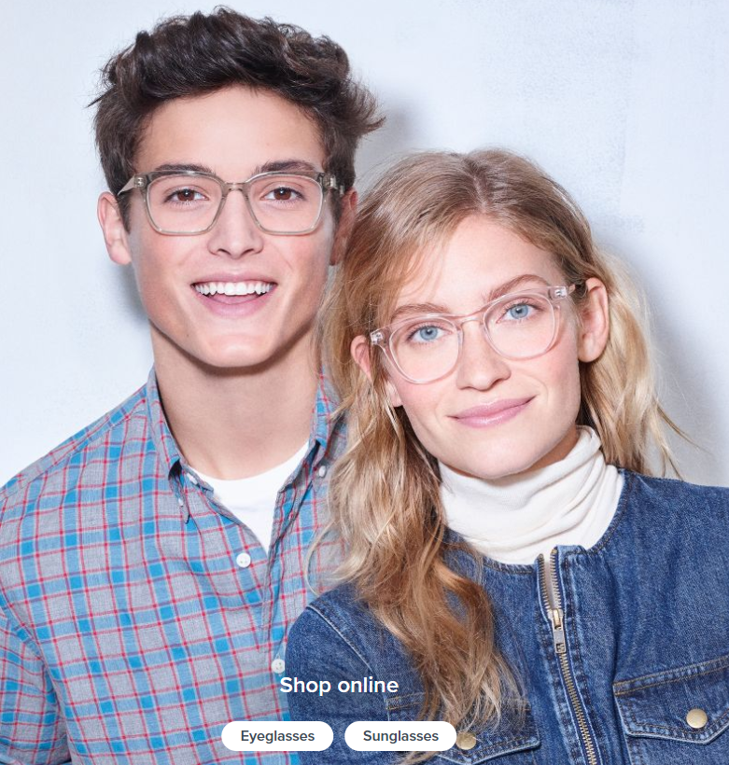
Warby Parker’s Marketing Funnels
Learn SQL From Scratch

Slide 2
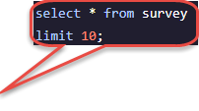
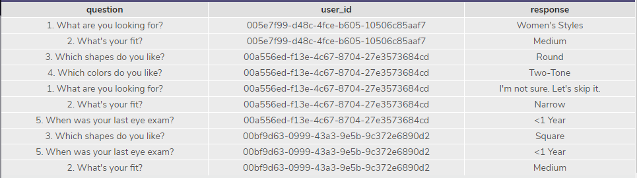
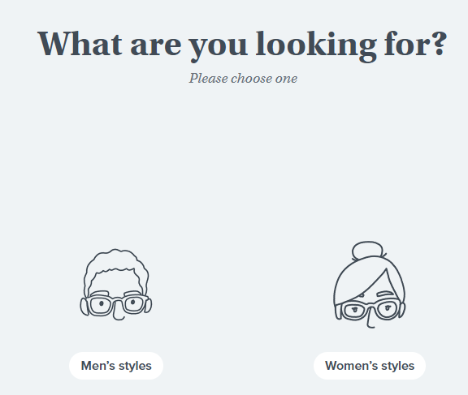
Survey table (Question #1)
To help users find their perfect frame, Warby Parker has a Style Quiz. The users’ responses are stored in a table called survey.
The columns in the survey table are “question”, “user_id”, and “response

Slide 3
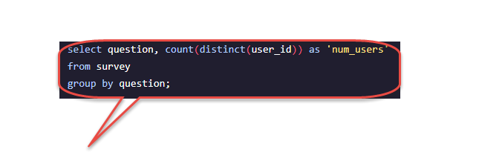
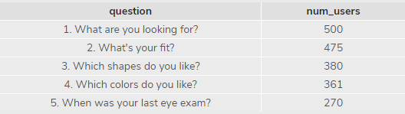
Number of Users Answering Each Question in the Survey (Question #2)
As can be seen, users will “give up” at different points in the survey. In creating a quiz funnel from the survey table, we can analyze how many users move from Question 1 to Question 2.
The table shows that 500 users answered Question 1. Of those users, 475 users answered Question #2, 380 answered Question #3, 361 answered Question #4, and 270 answered Question #5.

Slide 4
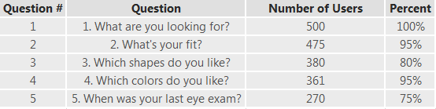
Percentage of Users Answering Each Question in the Survey (Question #3)
From the quiz funnel shown in the previous slide, we can calculate the percentage of users who answered each question.
In analyzing the completion rates from the table above, we see that Question 5 had the lowest completion rate and Question 3 had the second lowest completion rate. Question 5 may have had the lowest completion rate because the question is no longer relevant to understanding the style of glasses that the customer wants to purchase.
Note: If user does not know when his/her last exam was, there is an option to select “Not Sure. Let’s Skip It” so the completion rate can’t necessarily be low because the user doesn’t remember his last exam.

Slide 5
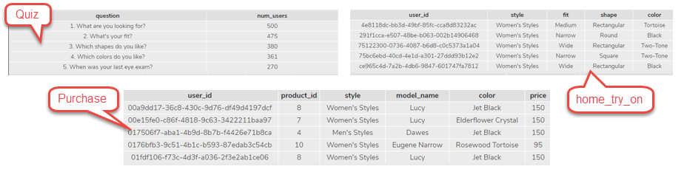
Warby’s Purchase Funnel (Question #4)
The data used for Warby’s Purchase funnel is distributed across 3 tables: the quiz, home_try_on, and purchase tables
The columns in the Quiz table are ‘Question’ and ‘num_users’
The columns in the home_try_on table are ‘user_id’, ‘style’, ‘fit’, ‘shape’, and ‘color’
The columns in the purchase table are ‘user_id’, ‘product_id’, ‘style’, ‘model_name’, ‘color’, and ‘price’.

Slide 6
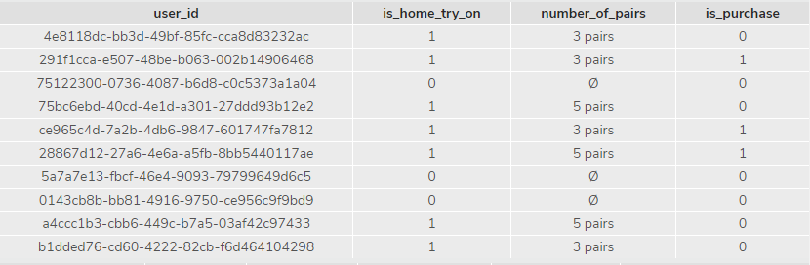
Warby’s Purchase Funnel (Question #5)
To analyze Warby’s purchase funnel, we use a left join to combine the 3 tables in the previous side, starting with top of the funnel (quiz table) and ending with the bottom of the funnel (purchase table).
To understand a user’s movement thru the funnel we also create two columns, is_home_try_on and is_purchase, by evaluating if the user id in the browse (quiz) table exists in the home_try_on table and the purchase table. The number_of_pairs column from the home_try_on table is also included for later analysis
Ex: The user represented in the first row of the table took the quiz, tried on 3 pairs of glasses at home, but did not make a purchase.

Slide 7
Warby’s Purchase Funnel (Question #5)
To analyze Warby’s purchase funnel, we use a left join to combine the 3 tables in the previous side, starting with top of the funnel (quiz table) and ending with the bottom of the funnel (purchase table).
To understand a user’s movement thru the funnel we also create two columns, is_home_try_on and is_purchase, by evaluating if the user id in the browse (quiz) table exists in the home_try_on table and the purchase table. The number_of_pairs column from the home_try_on table is also included for later analysis
Ex: The user represented in the first row of the table took the quiz, tried on 3 pairs of glasses at home, but did not make a purchase.

Slide 8

Actionable Insights (Question #6)

Slide 9

Overall Conversion Rates and Rate Comparison
Using the funnel that was created through SQL in the previous slide, we can calculate overall conversion rates by aggregating across all rows. Furthermore, we can compare conversion rates from the different stages in the funnel quiz → home_try_on and home_try_on → purchase.
From the table above, we see that a total of 10 users took the quiz. Of the 10 users that took the quiz 7, took pairs of glasses to try on at home. The quiz_to_home conversion rate is therefore 70%, as indicated in the column quiz_to_home. Of the 7 users that took pairs to try on at home, 3 users purchased the glasses. The home_to_purchase conversion rate is 42.86%, as indicated in the column ‘home_to_purchase’.
*Note: Results indicative of only a sample of 10 (Limit 10) per instructions in original Capstone project question

Slide 10
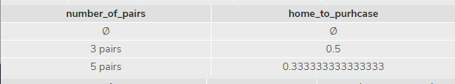
Differences in Purchase Rates
We can calculate the difference in purchase rates between customers who had 3 number_of_pairs with ones who had 5.
In the table above, we see that the purchase rate for users who had 3 number_of_pairs was 50% while the users who had 5 number_of_pairs was 33.33%. Users with 3 pairs had a higher conversion rate than those with 5 pairs.
*Note: Results indicative of only a sample of 10 (Limit 10) per instructions in original Capstone project question

Slide 11
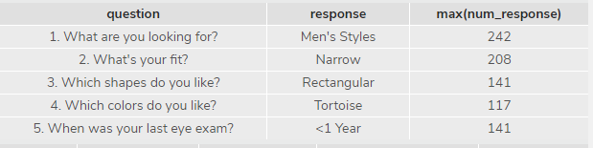
Most Common Responses to Quiz Questions
From the original tables quiz, home_try_on, and purchase; we can also make calculations. From querying the quiz table, we can find the most common responses to the quiz questions.
From the query result above, it appears that a majority of the users were looking for Men’s Styles, narrow fit, rectangular ship, tortoise color, and had their last eye exam <1 year.

Slide 12

Most Commonly Purchased Style
From querying the purchase table, we can find the most common style purchased.
From the table above, we see that Women’s Styles rather than Men’s Styles were more commonly purchased.

Slide 13
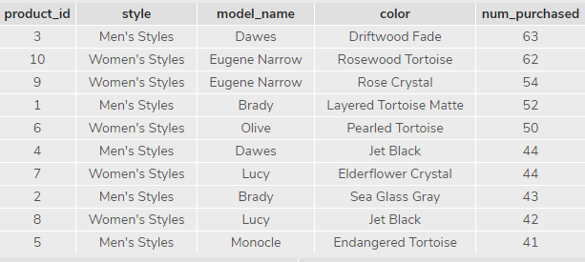
Most Common Products Purchased
From querying the purchase table, we can find the most common products purchased.
The table above shows that product id = 3 is the most commonly purchased product. 63 purchases were made of the Men’s Styles Dawes Driftwood Fade glasses.
Product_id = 10 was the second most commonly purchased product. 62 purchases were made of the Women’s Styles Eugene Narrow Rose Crystal glasses.

Slide 14
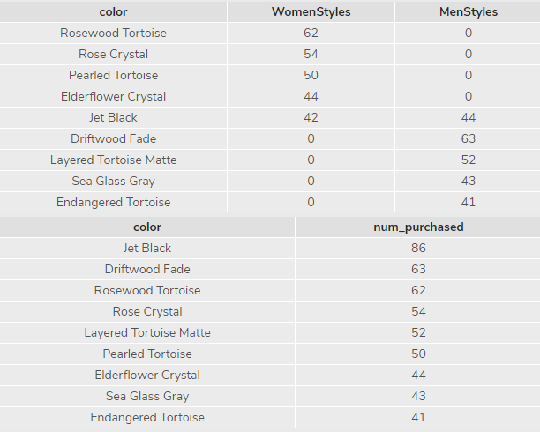
Most Commonly Purchased Color
From querying the purchase table, we can find the most commonly purchased colors. The first table shows the most commonly purchased color by style. Rosewood Tortiose is the most commonly purchased color in Women’s styles while Driftwood Fade is the most commonly purchased color in Men’s styles.
The second table shows us the most commonly purchased colors irrelevant of styles. Overall, Jet Black is the most commonly purchased color. It comes in both men and women’s styles.

Slide 15
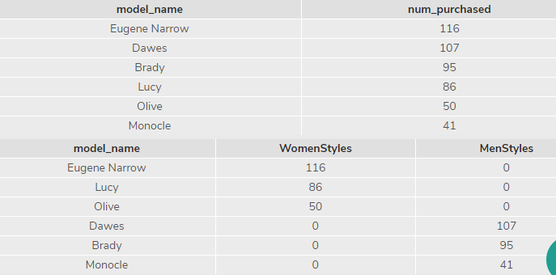
Most Commonly Purchased Model
From querying the purchase table, we can find the most commonly purchased models. The first table shows the most commonly purchased models overall. Eugene Narrow is the most commonly purchased followed by Dawes.
The second table shows us the most commonly purchased models by style. By looking at the models by style, we see that Eugene Narrow, Lucy, and Olive models are exclusive to Women’s styles while Dawes, Brady, and Monocle are exclusive to Men’s styles. Eugene Narrow is the most commonly purchased model for women’s styles and Dawes is the most commonly purchased model for men’s styles.

Slide 16
Thank You

